Slide 1
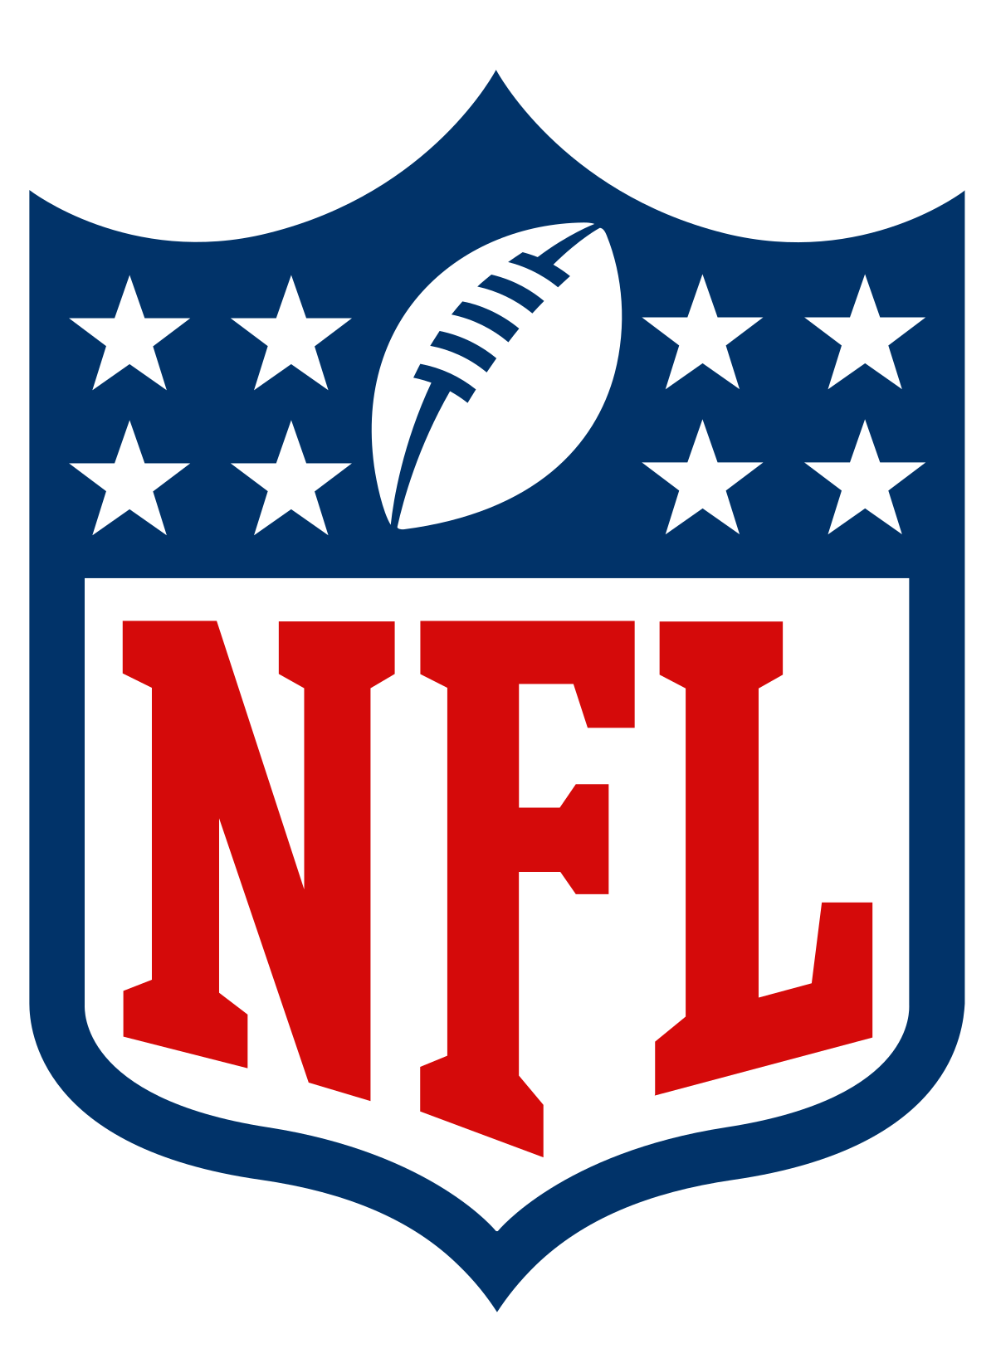
PREDICTING NFL Play calls for optimum success
Williams Anosike
DATA 06
This Photo by Unknown Author is licensed under CC BY-SA

Slide 2
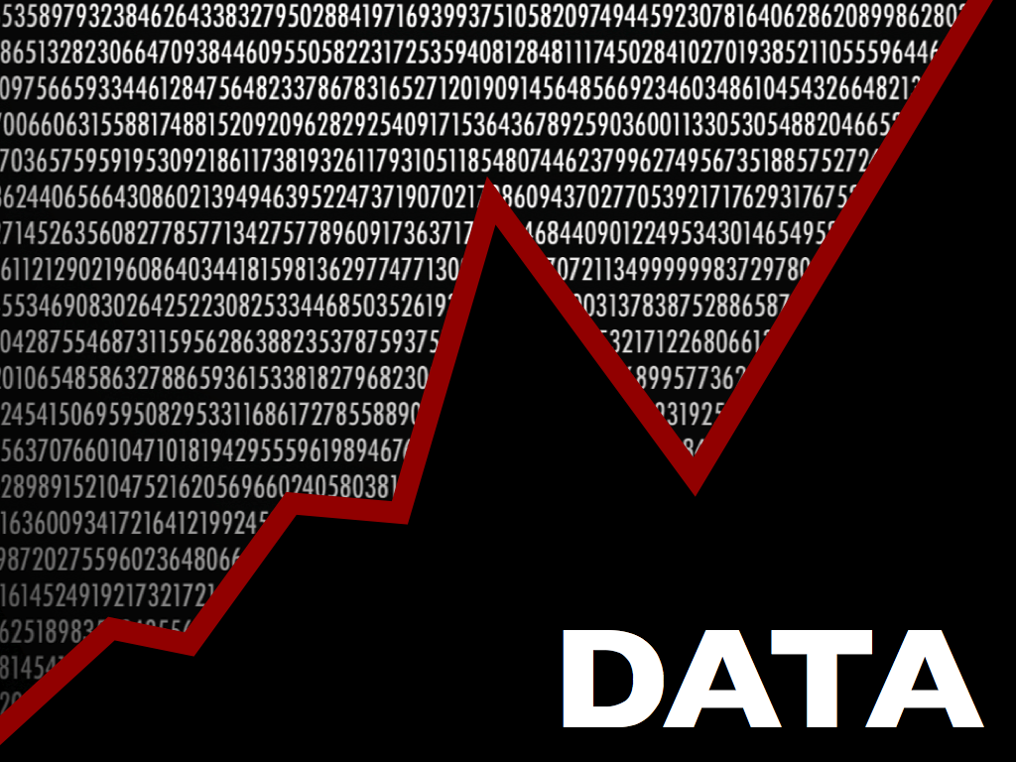
Dataset
The dataset contains all the regular season plays from the 2009-2018 NFL seasons. The dataset has 449,372 rows and 100 columns. Each play is broken down into great detail containing information on: game situation, players involved, results, and advanced metrics such as expected point and win probability values.
Compiled using an R package, nflscrapR which uses an API maintained by the NFL to scrape, clean, parse, and output clean datasets at the individual play, player, game, and season levels.
Was originally going to use a more usable dataset from https://www.armchairanalysis.com/nfl-data.php , but this required a substantial payment fee.
This Photo by Unknown Author is licensed under CC BY-NC-ND
This Photo by Unknown Author is licensed under CC BY-SA

Slide 3
introduction
What do I wish to accomplish?
The dataset is rather large, so I’m going to decrease the size of our problem by limiting our solutions to one team; the Washington Redskins (the best NFL team, by far!)
We will analyze their play-by-play data and use data science techniques to give them the best chance of success in the 2020 NFL season.
This Photo by Unknown Author is licensed under CC BY-SA

Slide 4
Project pipeline
Get the Data
Obtaining the dataset from its source and storing on my local machine.
Format the data
This will entail getting rid of unnecessary columns.
Data Analysis
To notice trends
Adding any columns that may be become important features for the model.
Dropping empty values (or filling them)
To get a general sense or outlook of our data
Ensuring that its in the right format that can be used in machine learning.
Set up Machine Learning Algorithm
The Machine Learning algorithm(s) we will apply in this project will be created in this stage.
Training Data on Model
Here I will train my formatted data on these algorithms and record accuracies to monitor progress.
Testing
Now here we will test our model for the 2020 NFL season.
Display Results
Showcase actions and results in an accessible manner for audience to see.
This Photo by Unknown Author is licensed under CC BY-SA

Slide 5
Inspiration
Sports. Sports. Sports. Been around it my whole life. From when I was 6 kicking a soccer ball in my backyard till today, where I play and watch soccer, basketball and football regularly.
Upon graduation, I want to get involved more in sports analytics. I want to provide guidance to make the tough decisions needed to be successful as a sports team.
This Photo by Unknown Author is licensed under CC BY-SA

Slide 6
Acknowledgement
Max Horowitz
Ron Yurko
Sam Ventura
This Photo by Unknown Author is licensed under CC BY-SA

